Slide 1
Billiards Trajectories
John Mikulskis

Slide 2
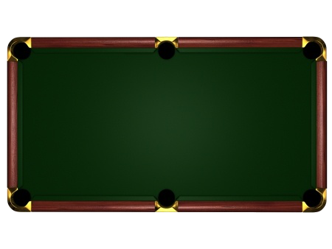

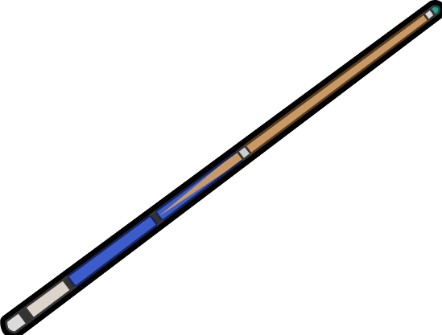
Introduction
Billiards has existed for several hundred years
8 ball pool, English snooker, 3 cushion, 9 ball, etc.
m
n

Slide 3
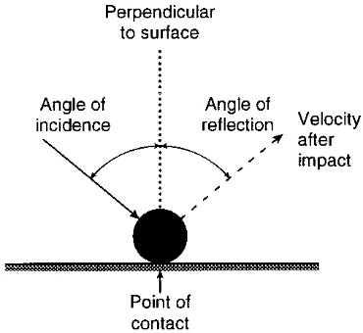
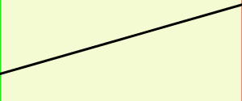
Some Rules
Bounces follow the law of optics
All energy is conserved
No spin on the ball
Ball has no volume
Angles will not be messy at corners

Slide 4
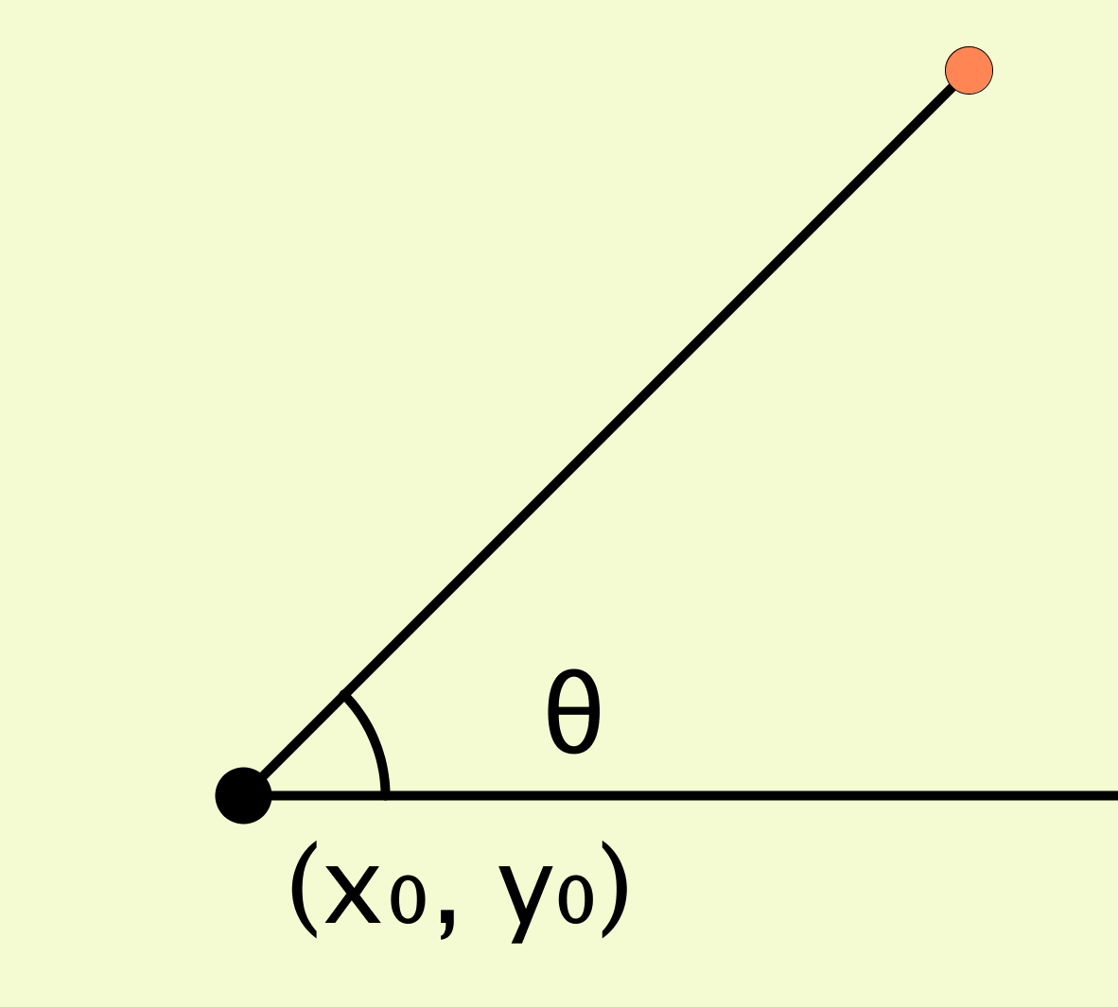
Table of [m x n] : m, n ∈ Z +
To analyze the path of travel:
Speed does not matter, so we
can just consider θ

Slide 5
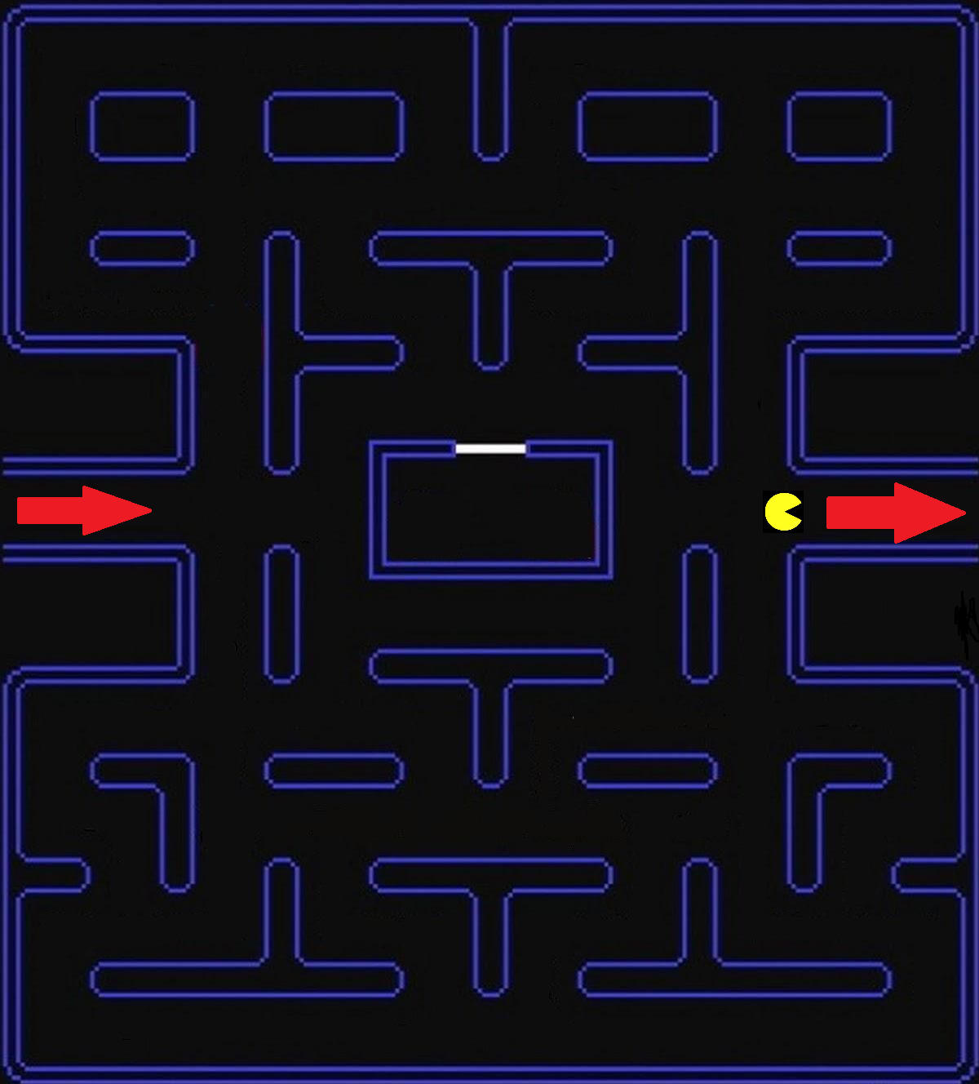
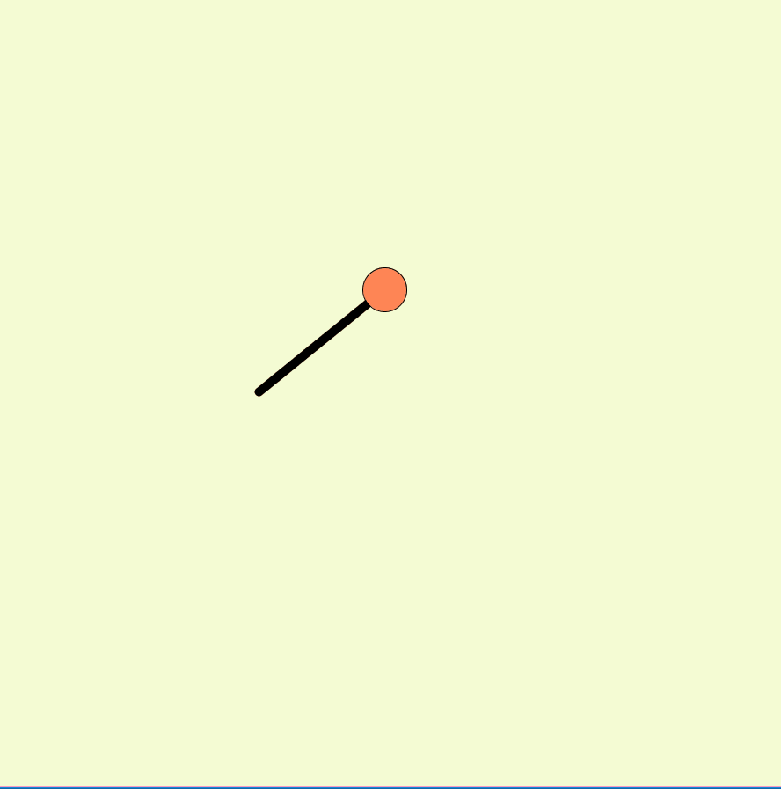
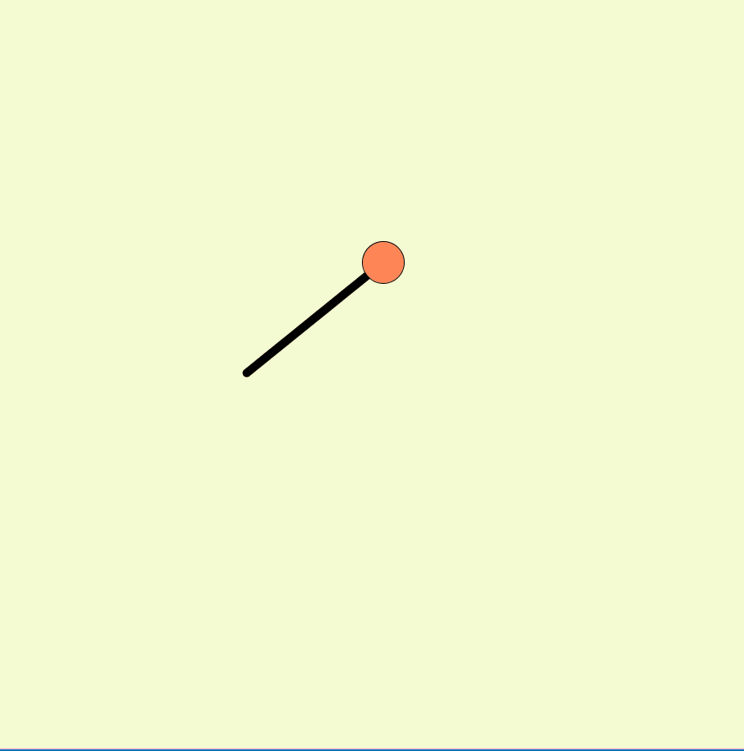
Challenges
It’s harder to analyze trajectories that bounce
We can start off by looking at a simpler form →Pacman Billiards
Normal Billiards
Pacman Billiards

Slide 6
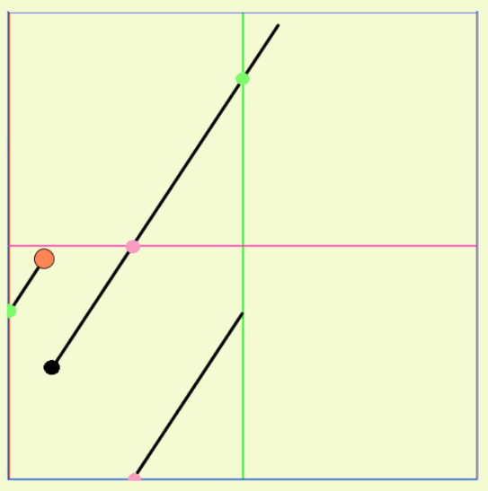
Duplicated Table Analysis
Duplicate tables are a direct copy of the original table
When stacked, they are just the adjacent table translated by m, -m, n, or -n
The path in a duplicated table is equivalent to the reflection of that path
No reflection needed in the duplicate table!
Notes:
The path in a duplicated table is equivalent to the reflection of that path, since the side of the original table that the path passes through corresponds to the opposite side of the duplicate table

Slide 7
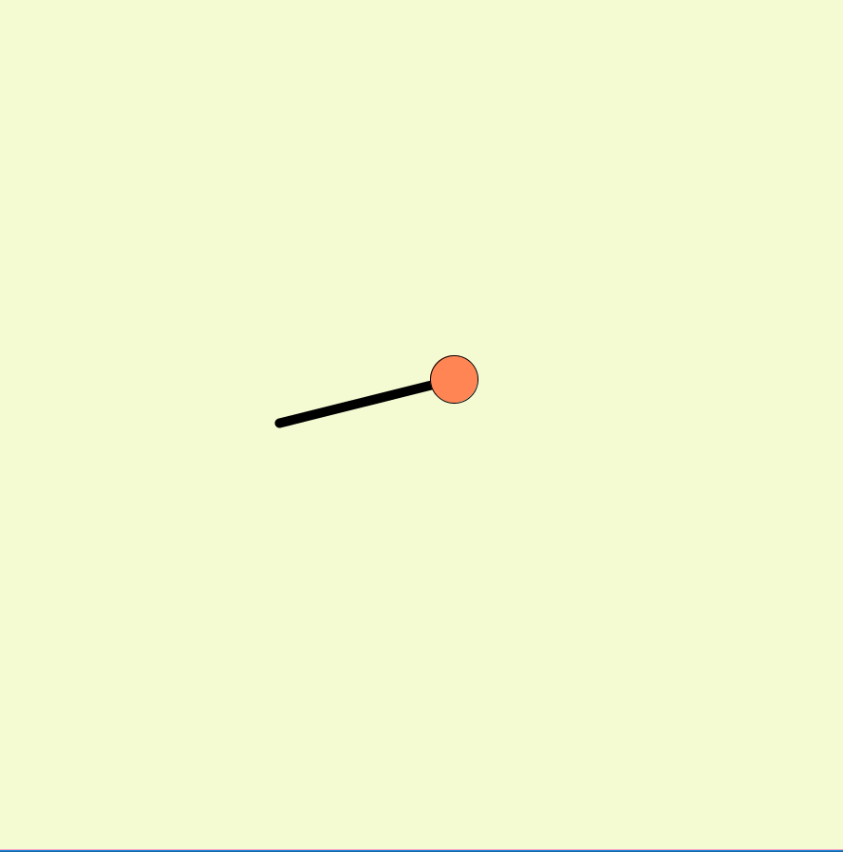
Closed Path Analysis
A path is “closed” if it returns back to its starting position at the same θ

Slide 8
Closed Path Analysis
For every point that the initial path goes through in a duplicated table, it also goes through in the actual table
Any paths which go through the starting point in a duplicated table will be closed

Slide 9
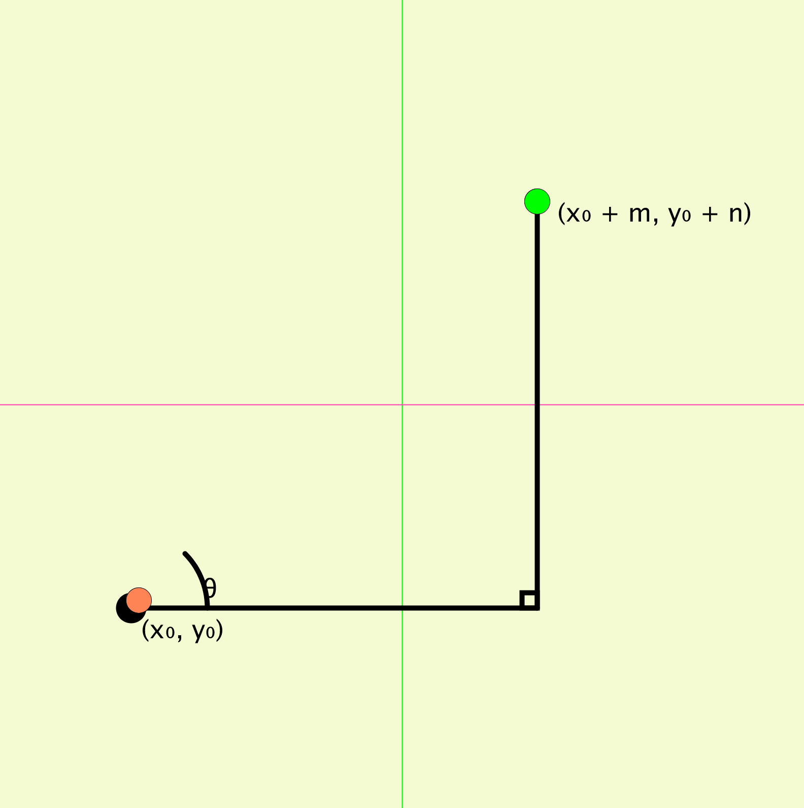
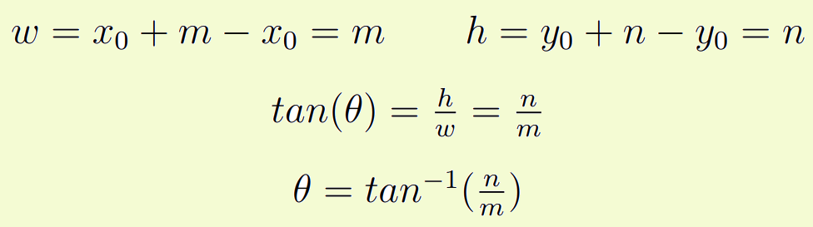
Finding θ for a path that closes up
The angle of the closed path is not dependent on the starting point

Slide 10
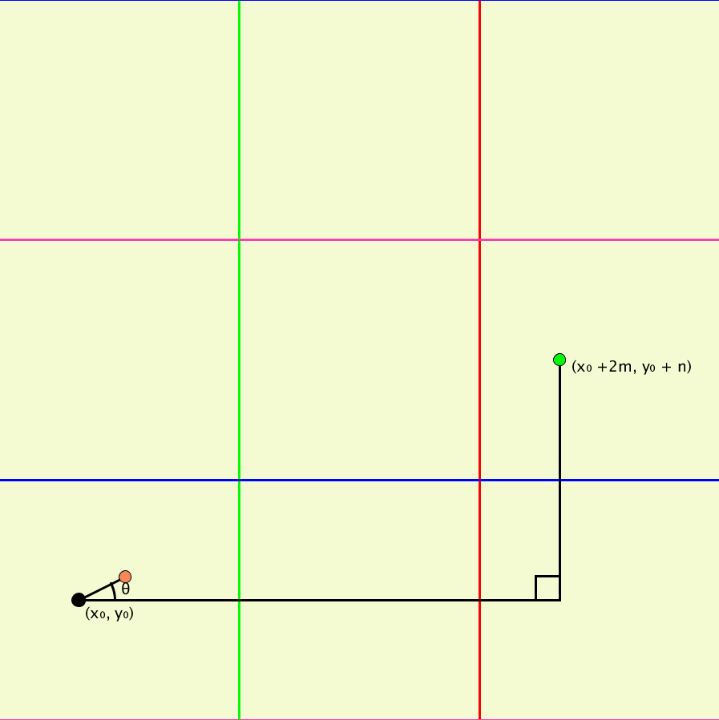
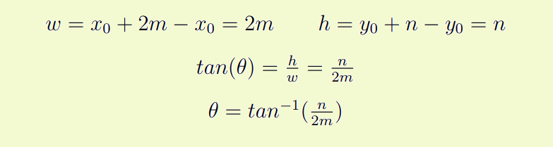
This θ is not unique
We can find a different table with the same starting point, and map a path to it

Slide 11
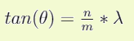
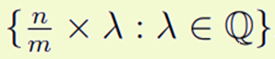
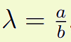
These closed paths have a pattern
λ is rational, as both a and b must be integers
For the intersection point…
a is its distance in vertical duplicated tables away (rows)
b is its distance in horizontal duplicated tables away (columns)
For every duplicated row or duplicated column that the ball goes through, another “Pacman reflection” is performed, so a + b = the number of unique reflections

Slide 12
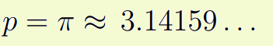
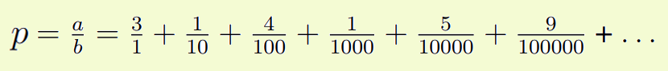
How about paths that don’t close up?
Paths that don’t close up must have an infinite number of unique reflections
Therefore, the tangent of the angle is irrational
a + b = # of unique reflections = ∞

Slide 13
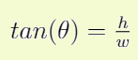
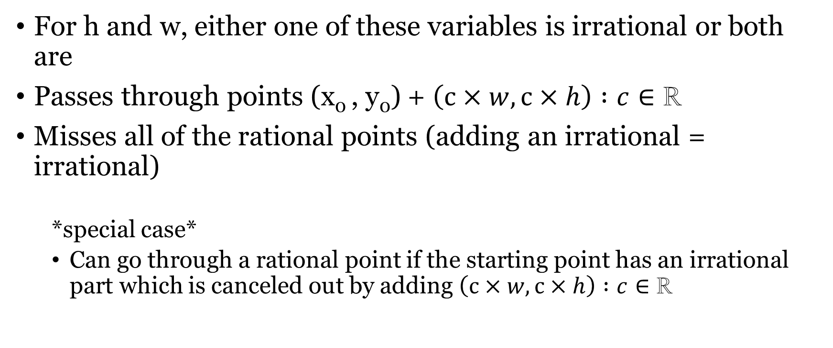
So does this path hit every point?
For h and w, either one of these variables is irrational or both are
Passes through points (x₀ , y₀) + $\left(c×w,c×h\right) :c∈\text{ℝ}$
Misses all of the rational points (adding an irrational = irrational)
*special case*
Can go through a rational point if the starting point has an irrational part which is canceled out by adding $\left(c×w,c×h\right) :c∈\text{ℝ}$

Slide 14
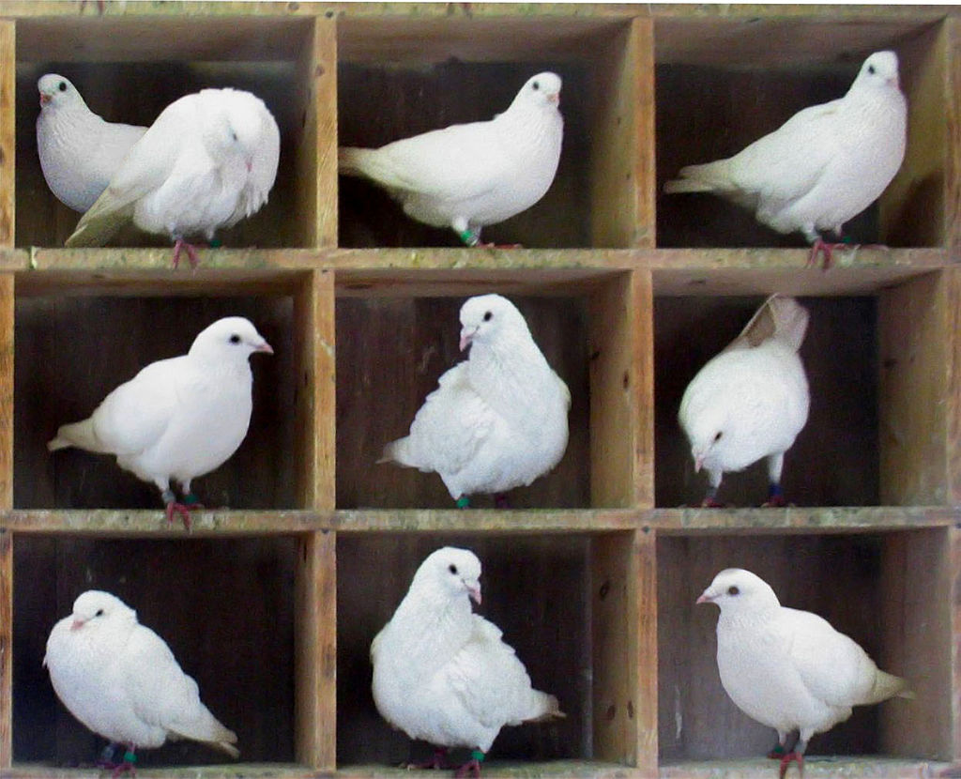
Does it pass through all table regions?
The pigeon hole principle
Notes:
The pigeon hole principle states that for finite sets, given n pigeons and m < n pigeonholes, at least one pigeonhole must contain more than one pigeon.

Slide 15

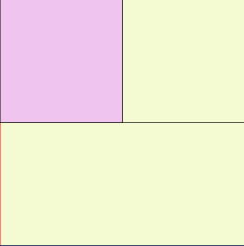
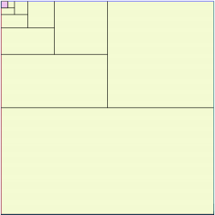
Does it pass through all table regions?
What if we have infinitely many pigeons?
Notes:
If infinitely many pigeons are stuffed into a finite number of pigeonholes, there will exist at least one pigeonhole having infinitely many pigeons stuffed into it

Slide 16
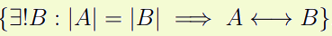
How does this help?
The pigeonhole principle only shows us that there exists some region, c, that the ball passes through infinitely many times, no matter what its size, within the larger region
Every path that goes through c gets reflected by the same rules, so there must exist some other region d that contains all of the reflections of c
c != d since the path does not close up
So for any region A,
Notes:
d that has the same cardinality of paths as c

Slide 17
Conclusion
The ball must pass through every region c, no matter what its size
Notes:
Since there is always a region of the same size that has an infinite number of paths passing through it by the pigeonhole principle, and there exists a bijection between this pigeonhole region and c

Slide 18
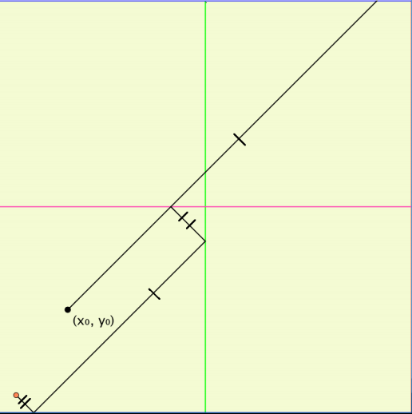
Real Billiards Analysis
Notes:
Hit top or bottom : Angle reflected across x axis
Hit one of the vertical sides : Angle reflected across y axis

Slide 19
Duplicated Analysis
Since the angles are flipped for every bounce, then the tables must be flipped too
2 flips is identity
Notes:
2 flips is identity, so for an even number of tables away horizontally or an even number of tables away vertically, the duplicated table is not flipped

Slide 20
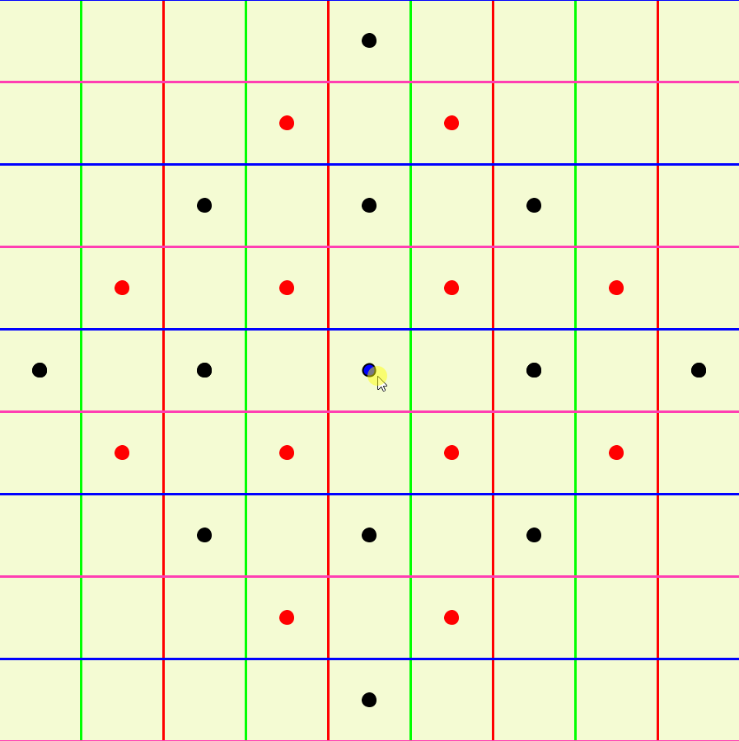

Slide 21
Closed paths in Real Billiards
Define z as the duplicated tables away horizontally
Define w as the duplicated tables away vertically
z + w must be even
Notes:
Even if the path passes through the starting point in a duplicated table, if z + w is not even, then the angle of the path will be perpendicular to θ when it intersects the starting point since there are an odd number of flips)

Slide 22
2 Different Types of closed paths
If z is even and w is even
We can denote this set of paths as S^{n} (the simple paths), where n = z + w
Otherwise, z and w are both odd
We can denote this set of paths as F^{n} (the flipped paths), where n = z + w
Notes:
If z is even and w is even, then these paths end up with an intersection in a duplicated table with no flip
Otherwise, z and w are both odd, so the path ends up intersecting its equivalent starting point in a duplicated table that is flipped across the x-axis and the y-axis

Slide 23
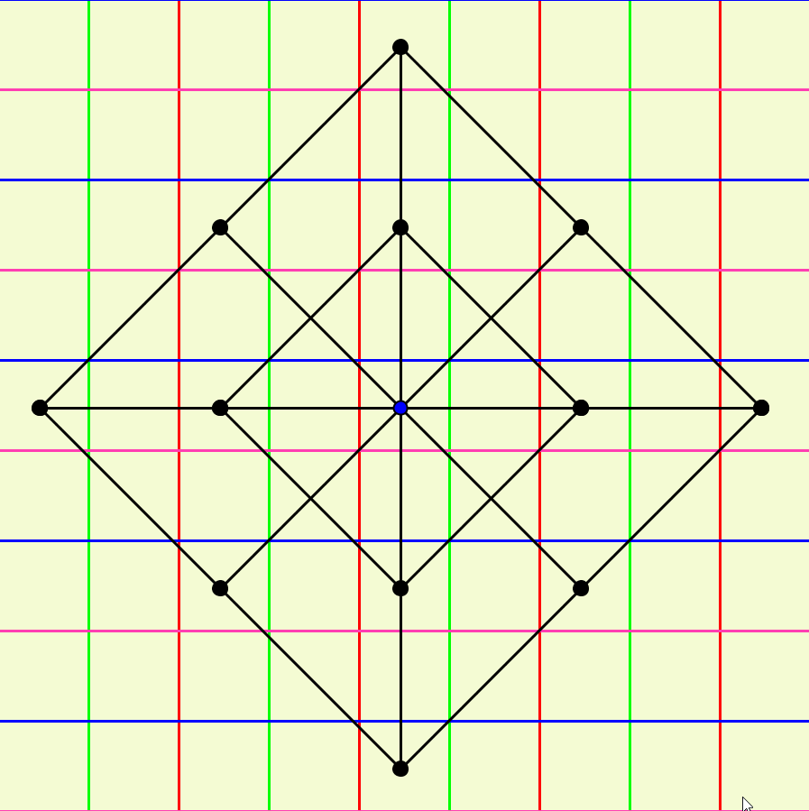
Graph of S² and S⁴

Slide 24
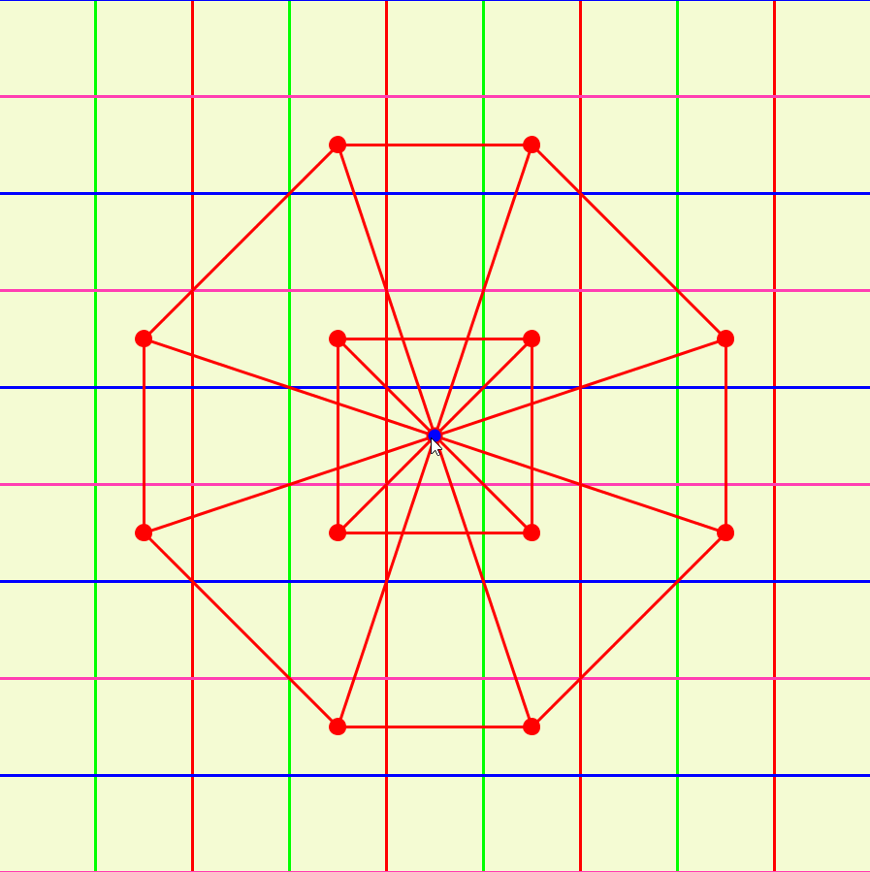
Graph of F² and F⁴

Slide 25
How many paths at each n?
Need to find pairs of (z, w) for which z + w = n
n + 1 pairs of (z, w)
2 of these pairs will always be (0, n) and (n, 0)
Each yields 2 paths
The rest of these pairs have z, w > 0
Each yields 4 paths
So 4n total paths for each n, since 4(n – 1) + 4 =4n – 4 + 4 = 4n
|S^{n}| = 2n
|F^{n}| = 2n
Notes:
Each yields 2 paths, since we can travel +n or –n tables for each pair
Each yields 4 paths, since we can travel +z, -z, +w, -w tables for each pair
2n of these lie in S^{n}, since half of them are due to pairs of evens
2n of these lie in F^{n}, since half of them are due to pairs of odds

Slide 26
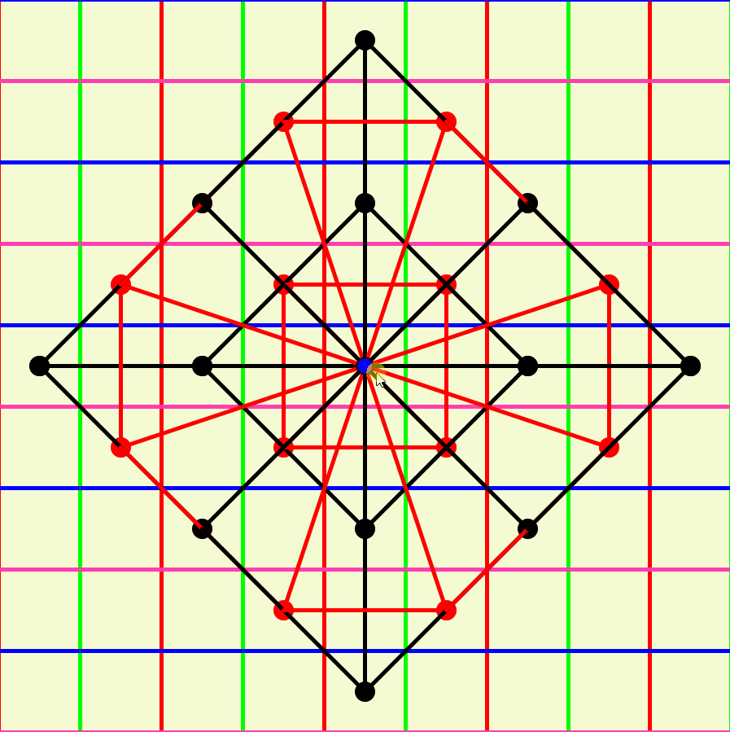
Notes:
Equivalent starting coordinate in one of the flipped tables is the same in the middle of the table as for one of the tables that isn’t flipped, so for this special case, all the points of intersection for F^{n} lie on the rhombus of S^{n}

Slide 27
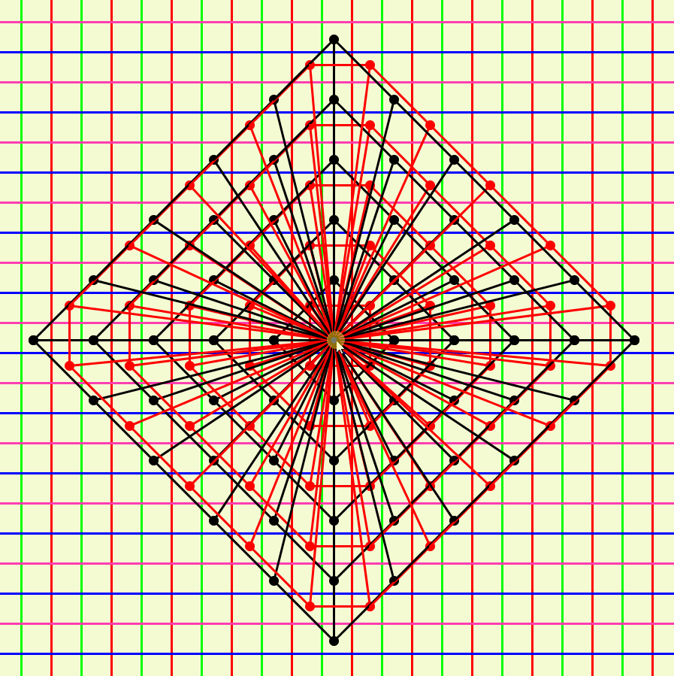

Slide 28
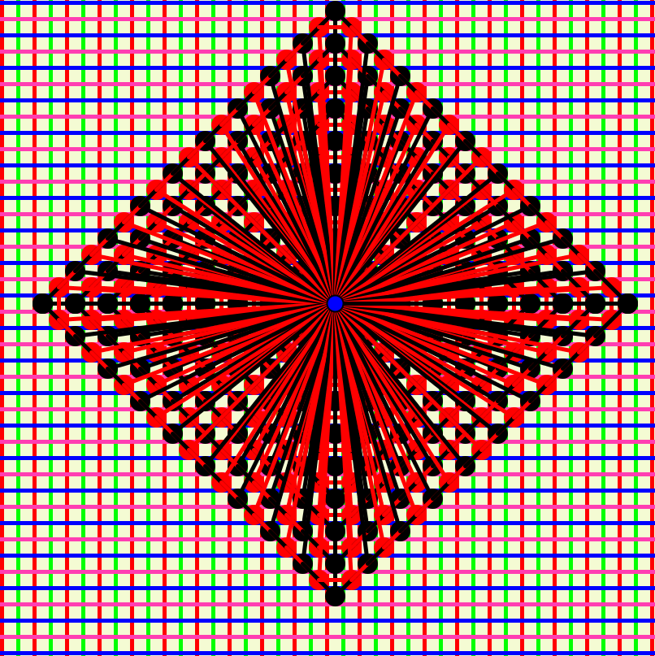
References
Medici, Dan. “Periodic Billiard Paths.” The Geometric Viewpoint, 25 Apr. 2014, web.colby.edu/thegeometricviewpoint/2014/04/25/periodic-billiard-paths/.
“Dirichlet's Box Principle.” From Wolfram MathWorld, mathworld.wolfram.com/DirichletsBoxPrinciple.html.
“Integer Equations - Stars and Bars.” Brilliant Math & Science Wiki, brilliant.org/wiki/integer-equations-star-and-bars/.

